Slide 1
Project Title: Chatbot with Watson

Slide 2
Problem Definition and Design Thinking

Slide 3
→ IBM Design Thinking Model explained
IBM Design Thinking: this article explains IBM Design Thinking or Enterprise Design Thinking in a practical way. Next to what it is, this article also highlights the User-centred Outcome, the importance of collaborative teams, the Loop of the model and the elements. After reading it, you will understand the basics of this creativity tool. Enjoy reading!
What is IBM Design Thinking?
Design Thinking has been an iconic tool for many companies in efforts to keep pace with the growing competency in the market. The technique is designed to establish a consumer-oriented culture within an organization.
IBM global software and hardware developer has had its breakthrough in its overwhelming efforts towards establishing a fast-paced scalable IBM Design Thinking process. This step away from the traditional Design Thinking process seeks to achieve a model more suitable for big enterprises.

Slide 4
User-centred Outcome through IBM Design Thinking
It should be noted that the traditional design thinking model is more applicable to the SME’s than the big enterprises which are built on complex processes.
IBM took its leap into Design Thinking on a large scale in the year 2013. The company brought over 750 designers, 10,000 employees and numerous teams on board in its strategic process to achieve a user-based culture that is deeply embedded in the company processes.
This greater leap in Design Thinking still aims at establishing a design-driven culture embedded in the steps akin to the traditional design thinking process which involves empathizing, defining, ideating, prototyping and testing.
The IBM Design Thinking Model is built on three principles: user-centred outcome, multidisciplinary collaborative efforts and the loop process that involves iterative reinvention. User-centred Outcome through IBM Design Thinking IBM Design Thinking puts the user needs first on its list of priorities. This means that every decision-making is embedded in the ultimate satisfaction of users.

Slide 5
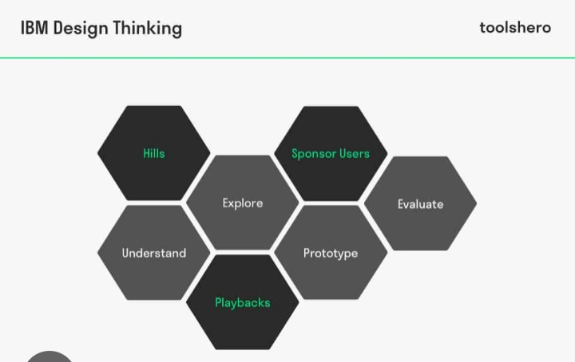

Slide 6
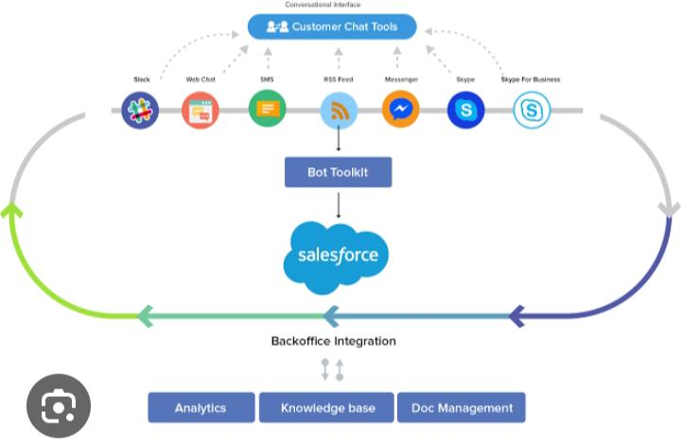

Slide 7
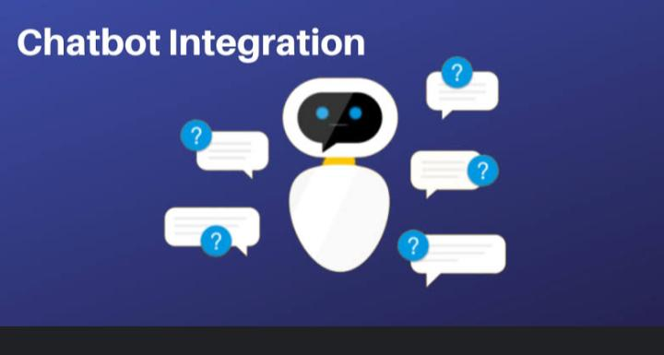

Slide 8
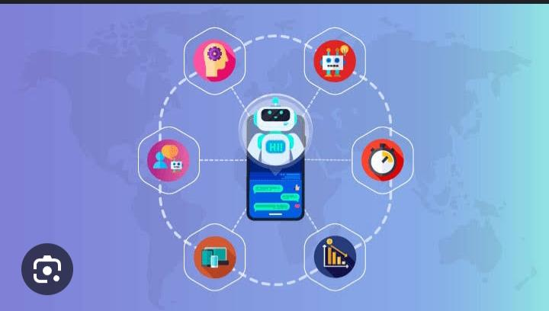

Slide 9
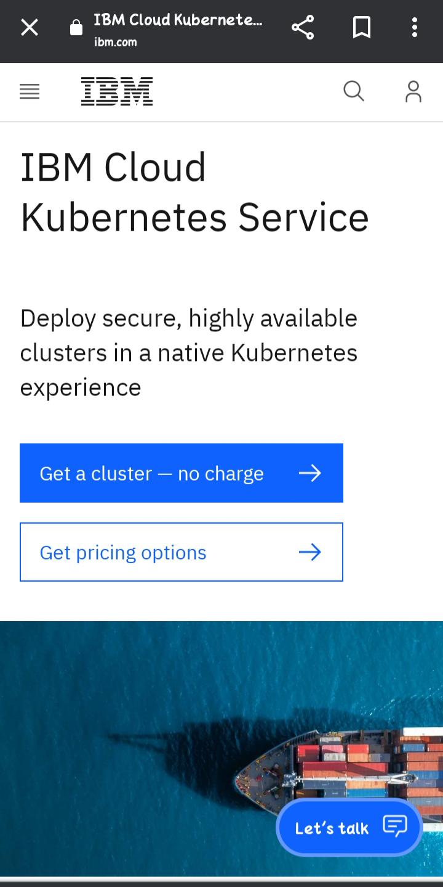

Slide 10
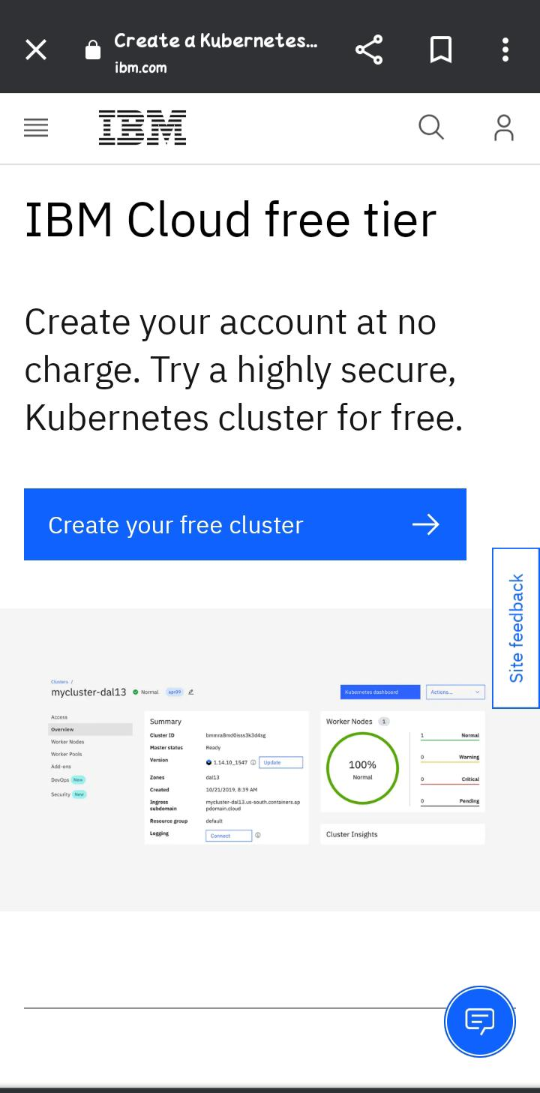

Slide 11


Slide 12
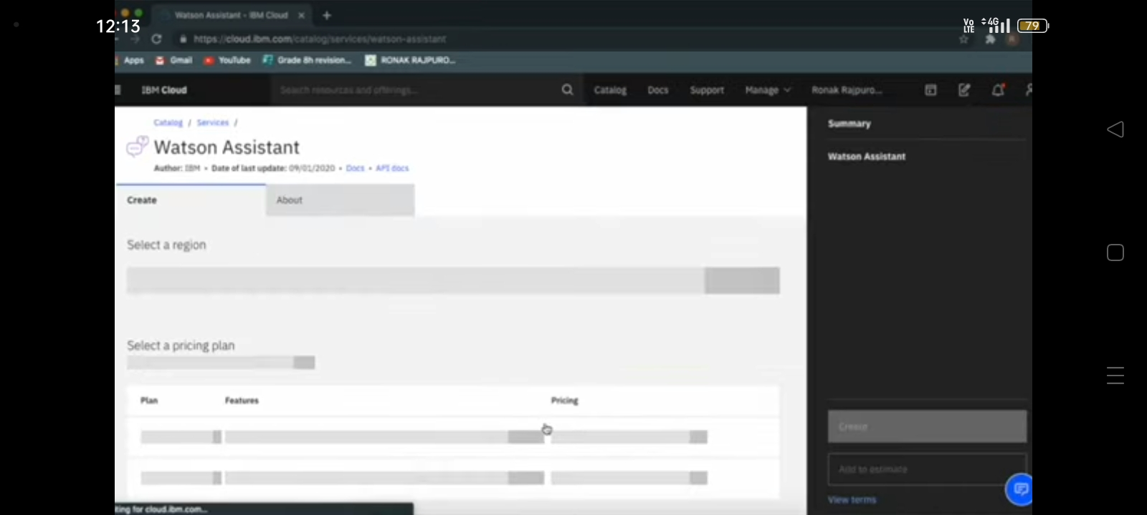

Slide 13
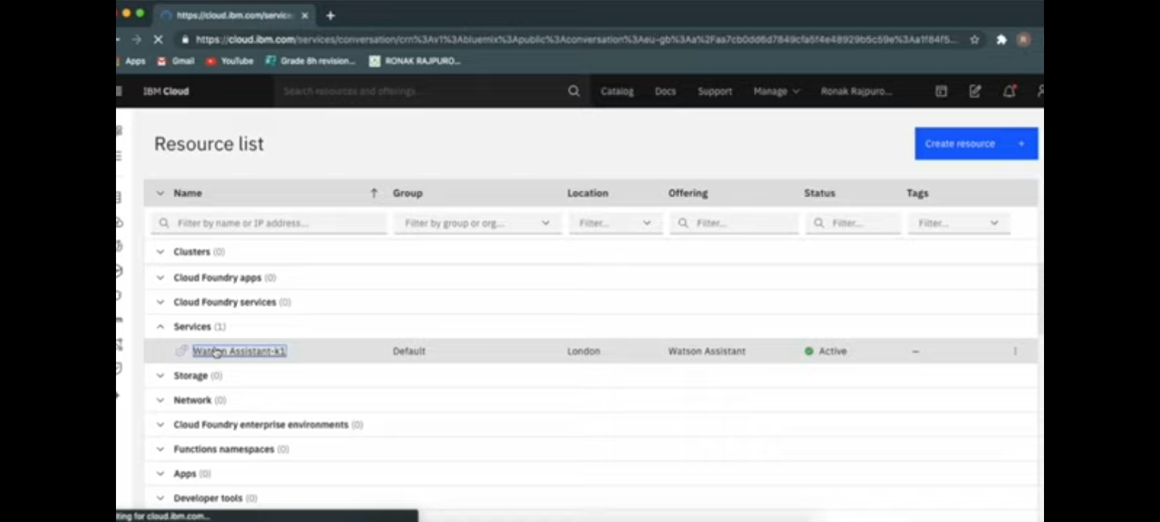

Slide 14
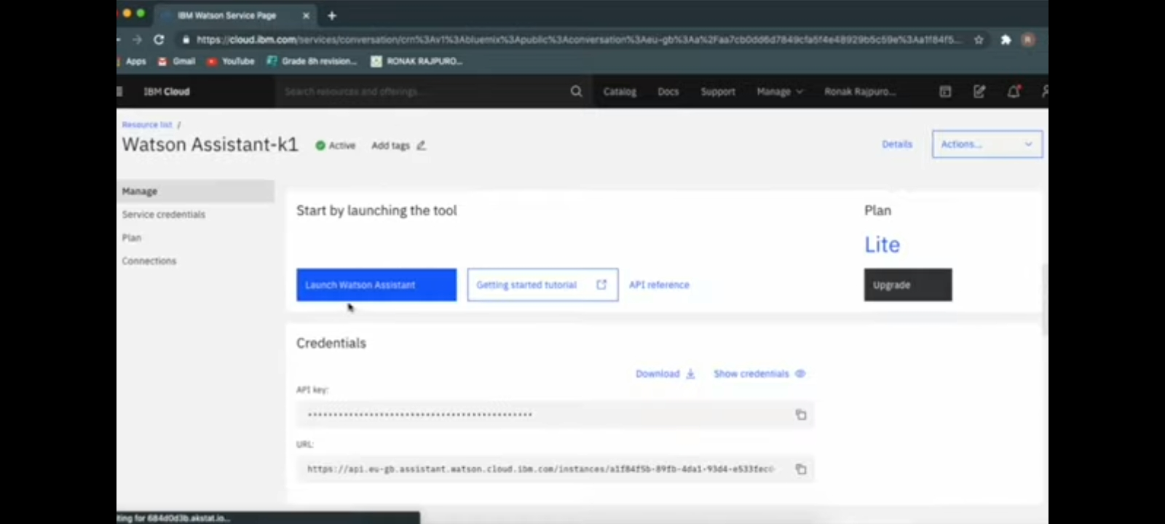

Slide 15
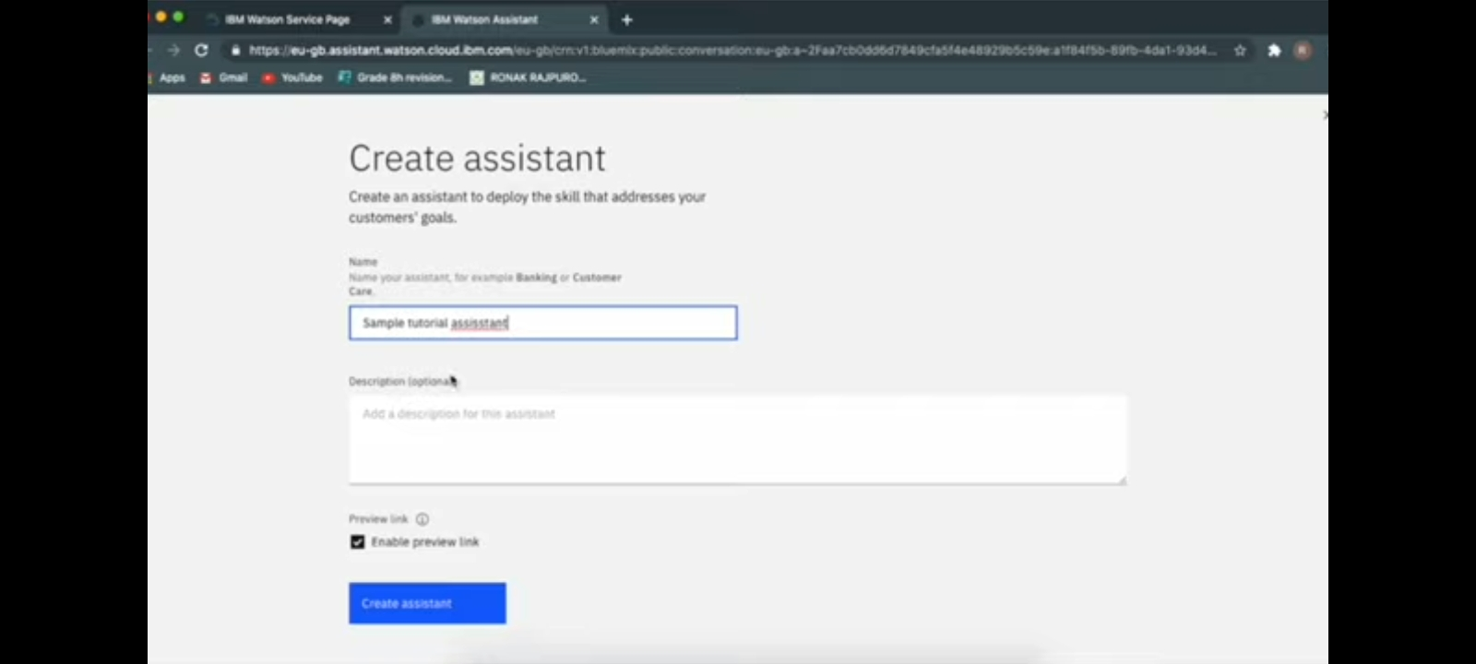

Slide 16
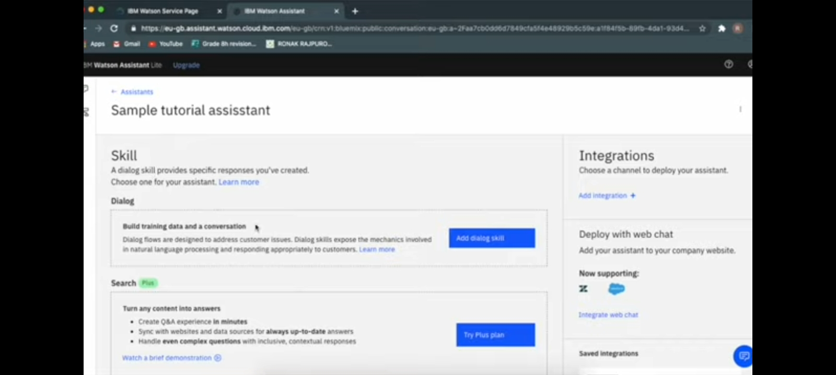

Slide 17
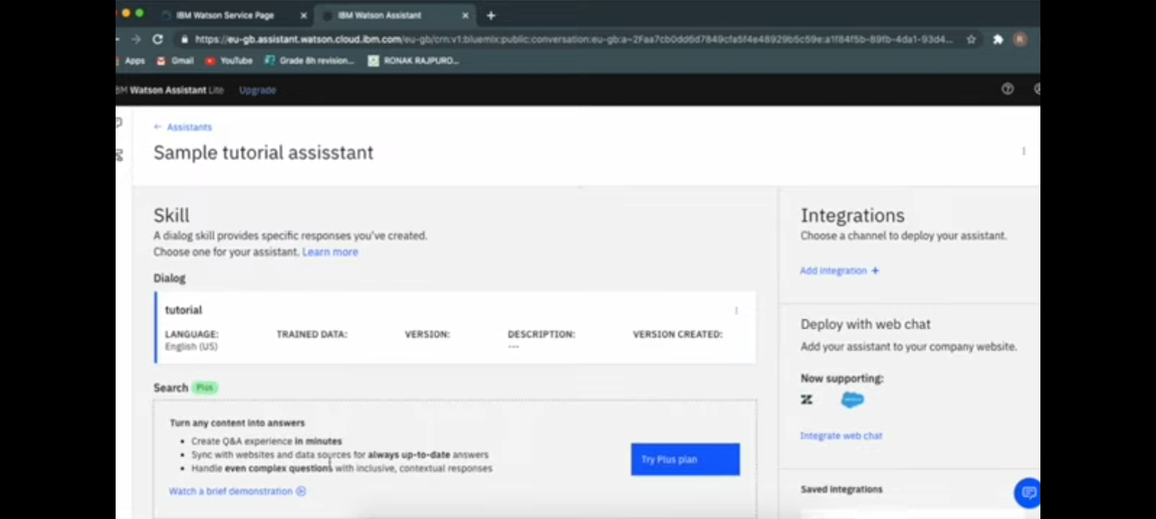

Slide 19
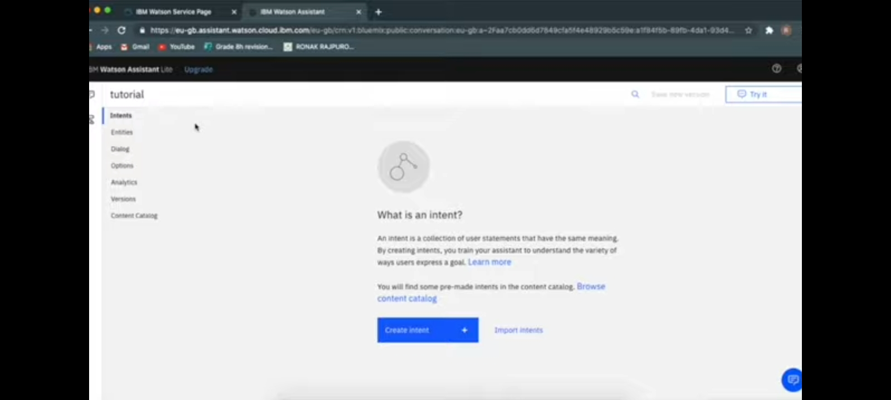

Slide 20
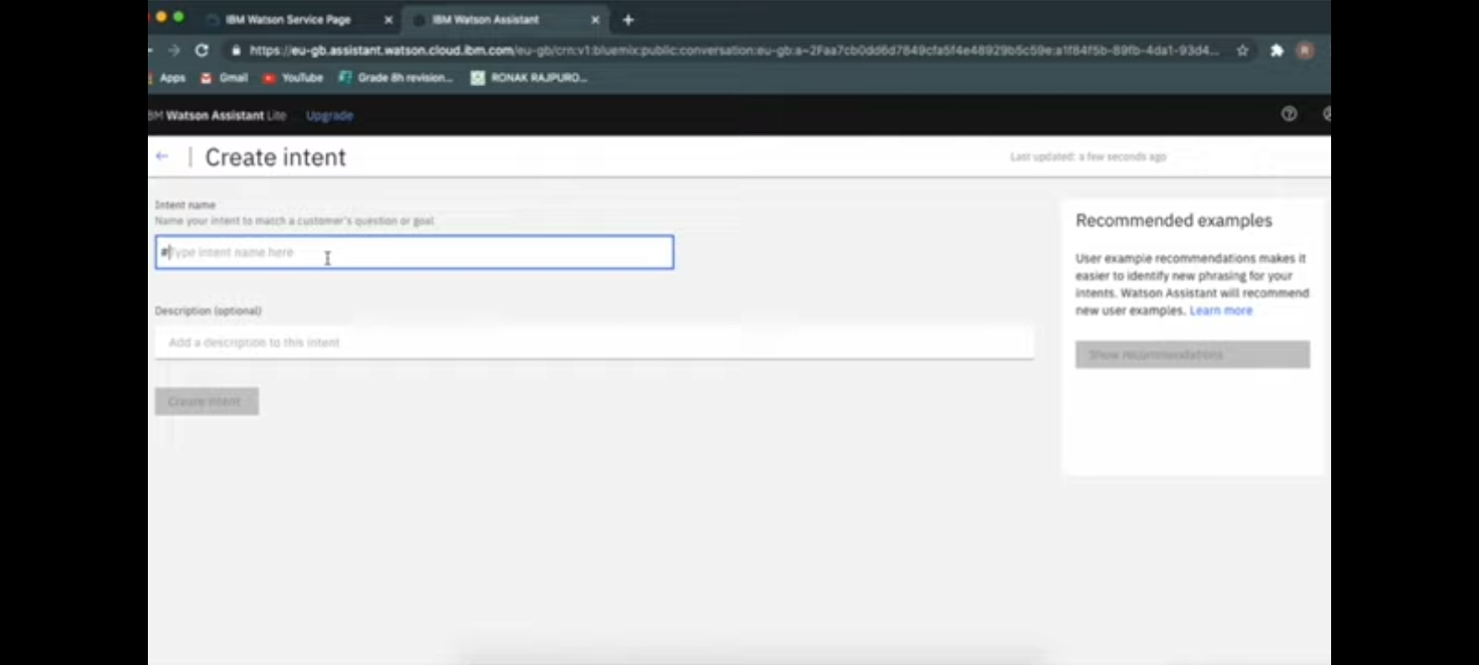

Slide 21
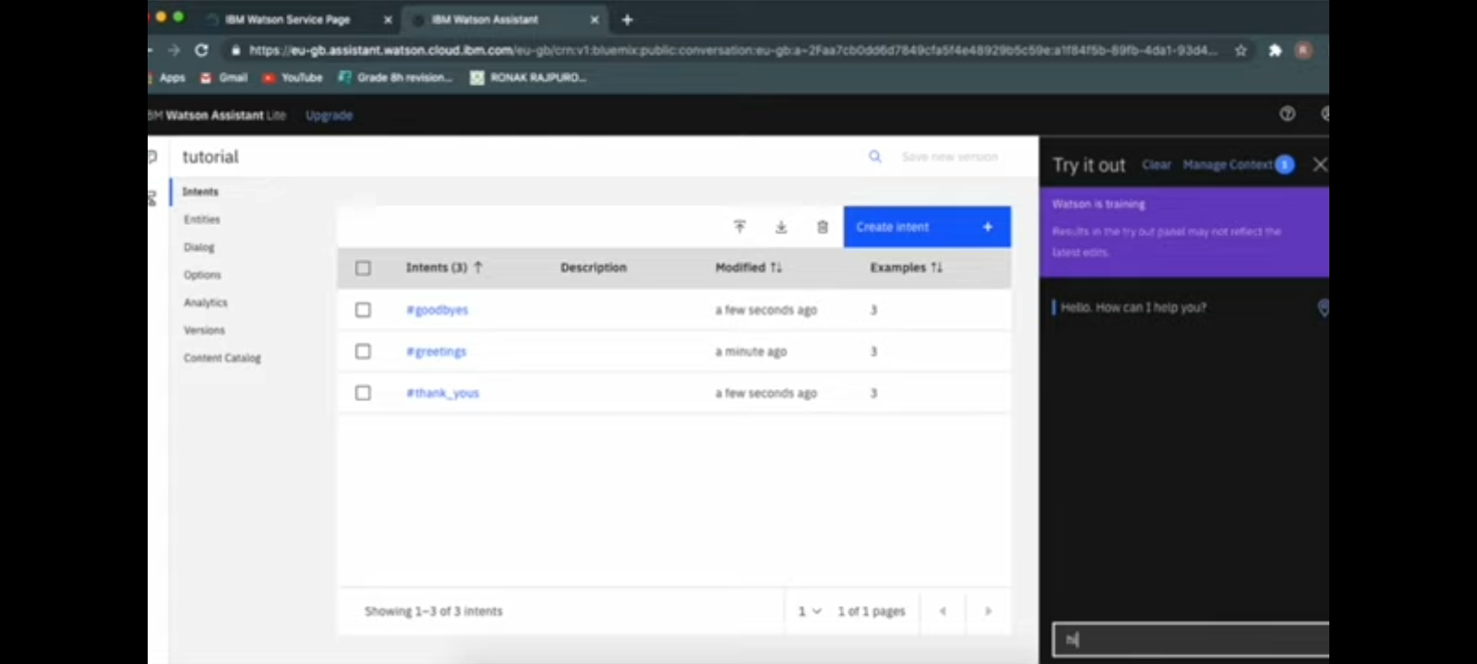

Slide 22
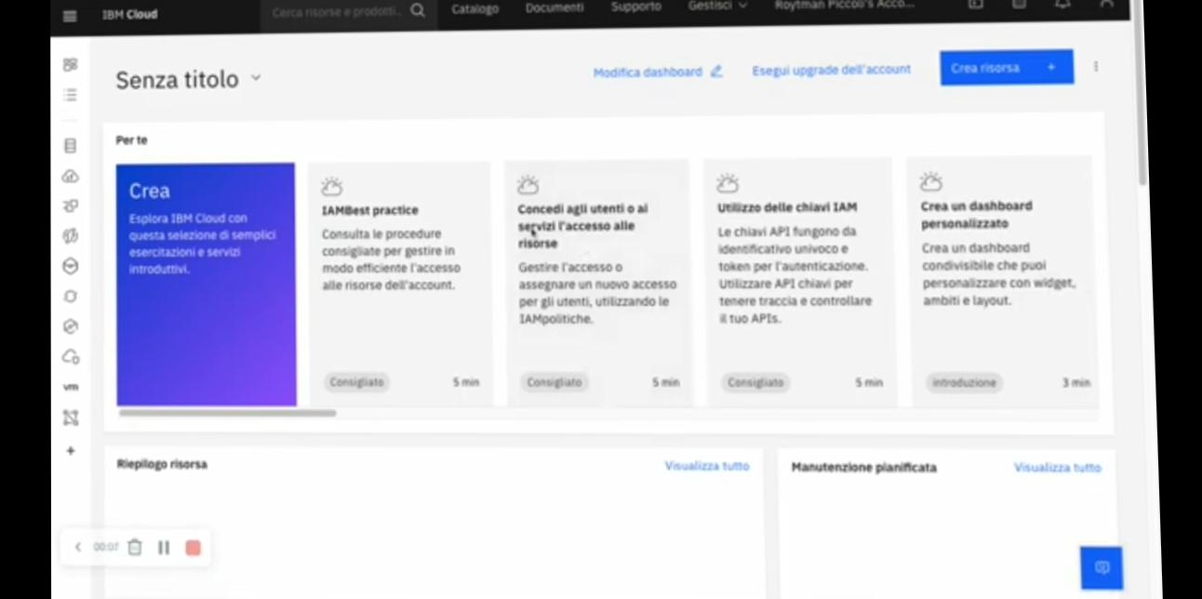

Slide 23
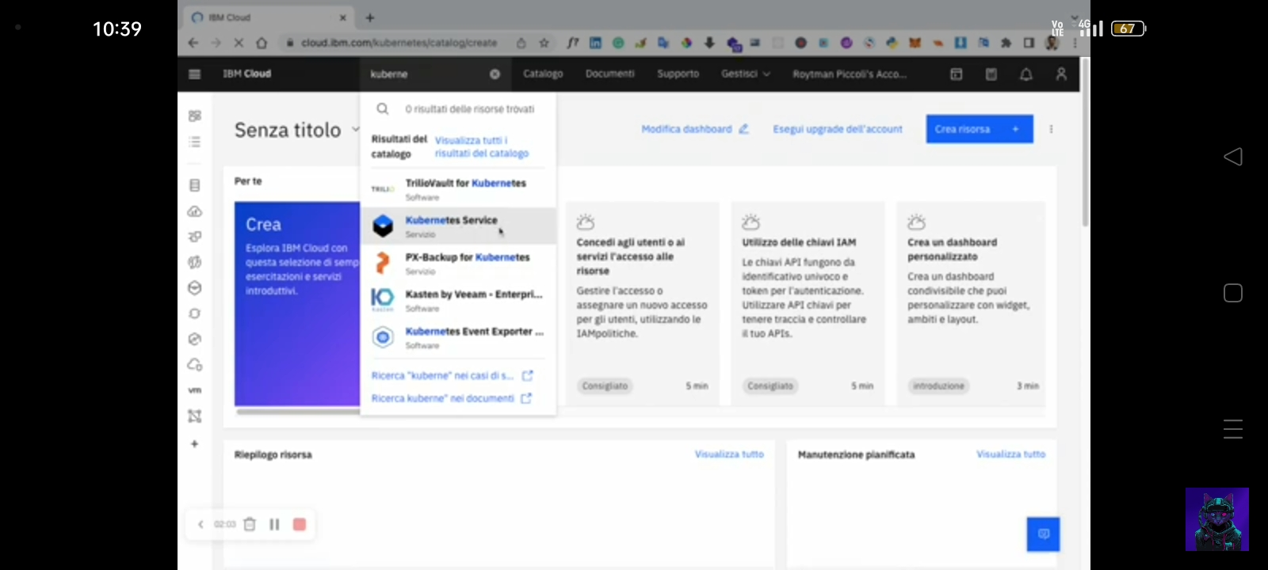

Slide 24
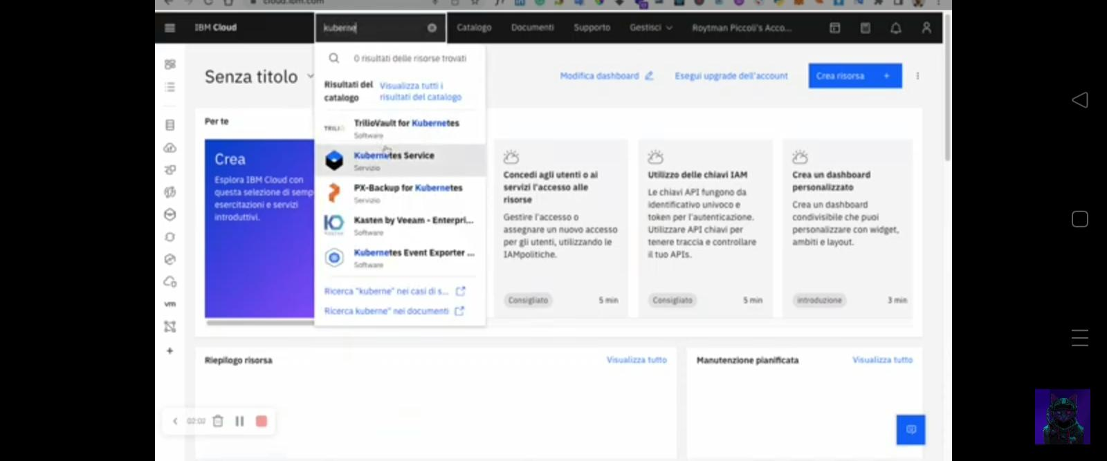

Slide 25
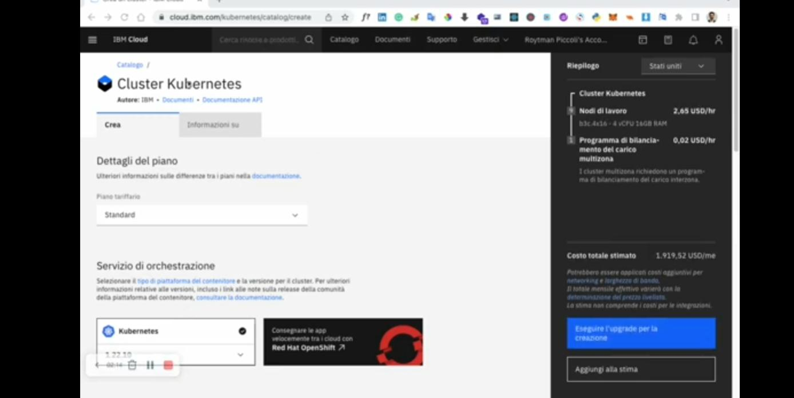

Slide 26
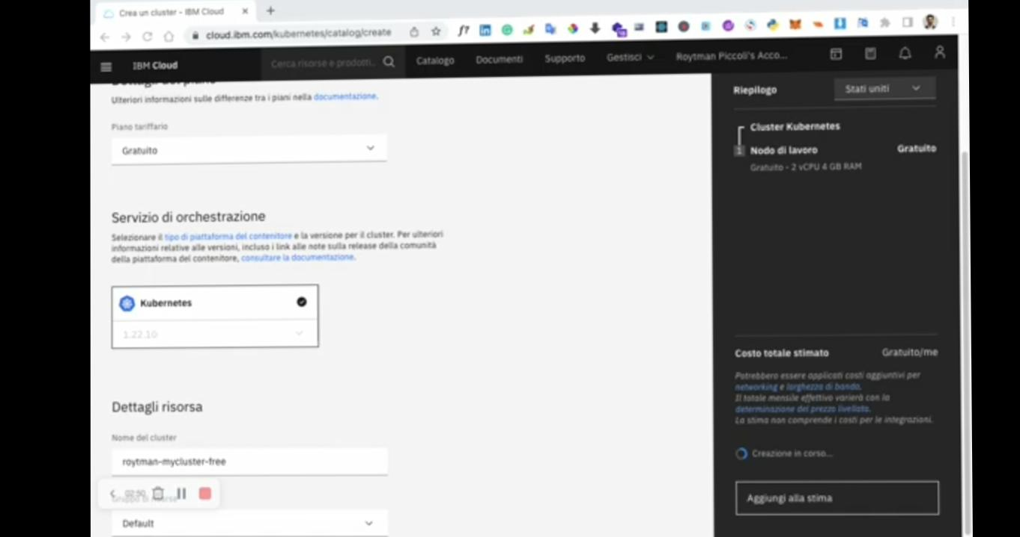

Slide 27
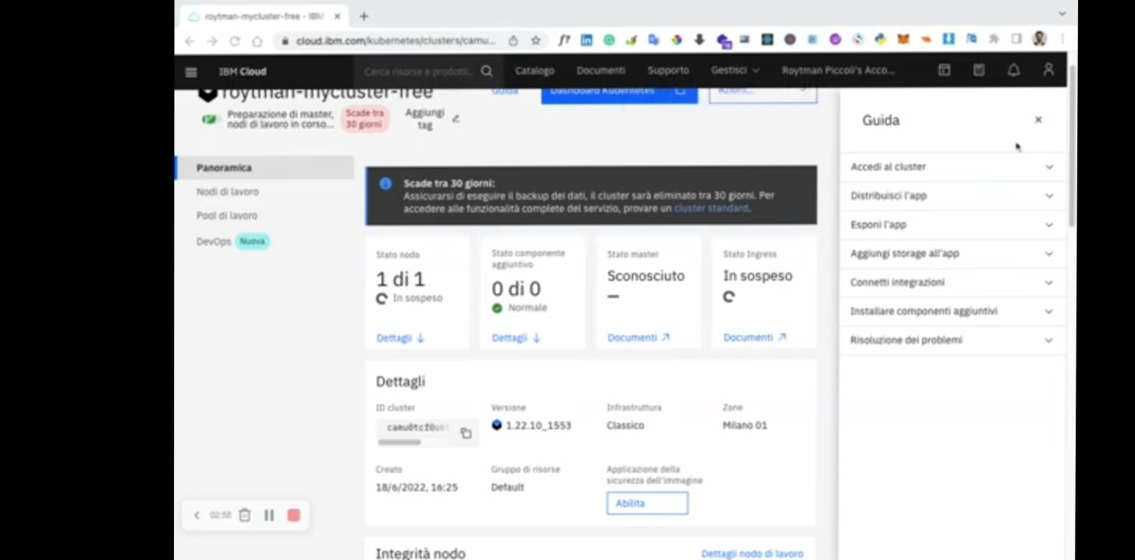

Slide 28
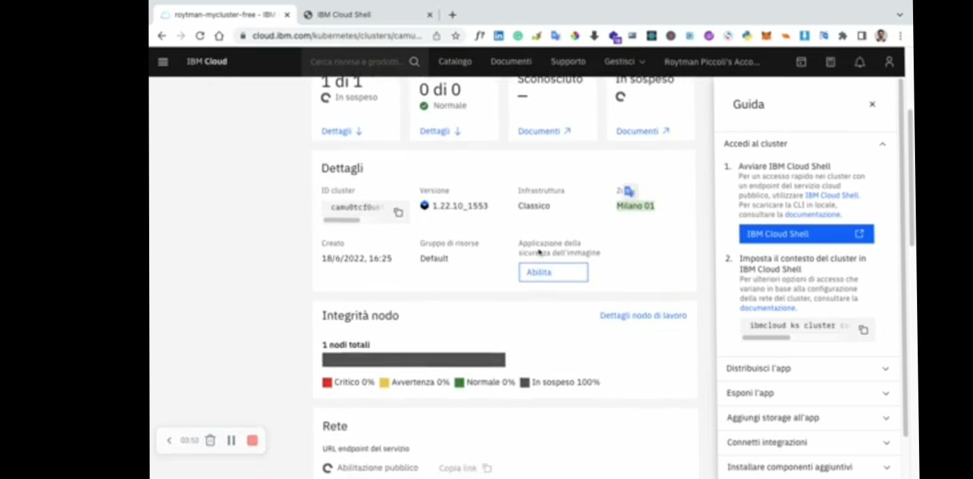

Slide 29
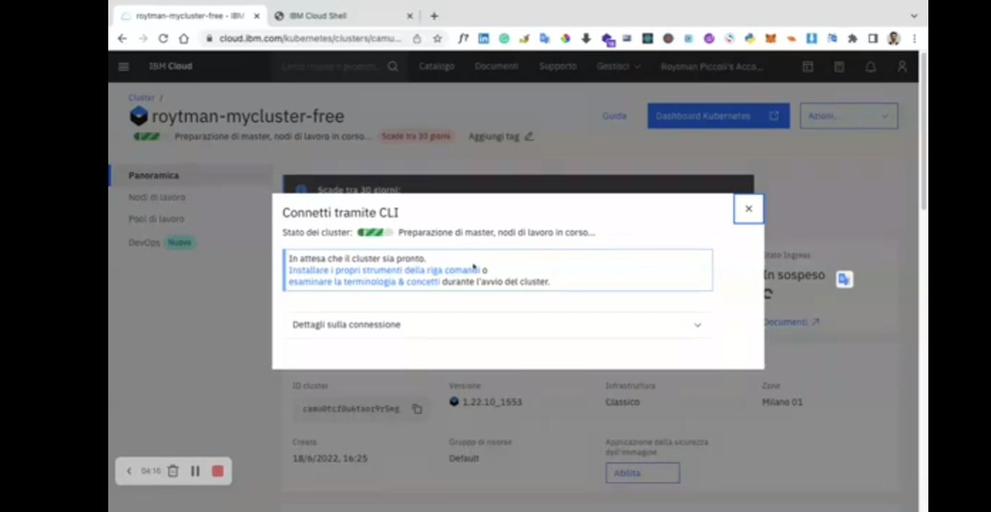

Slide 30
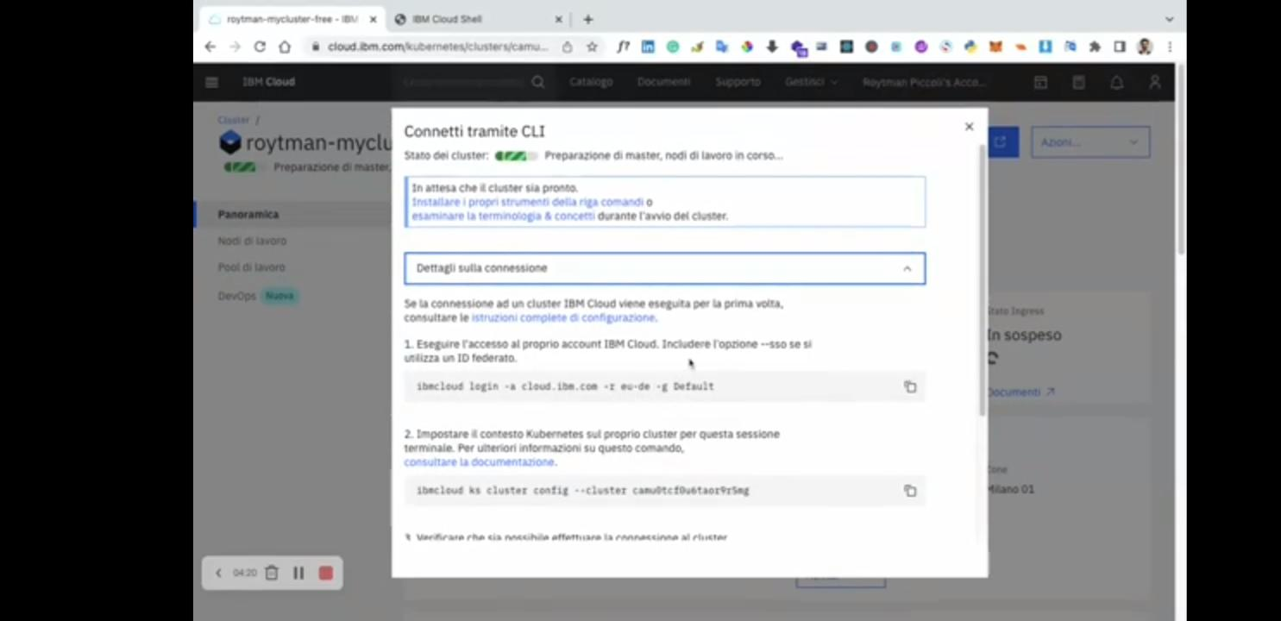

Slide 31
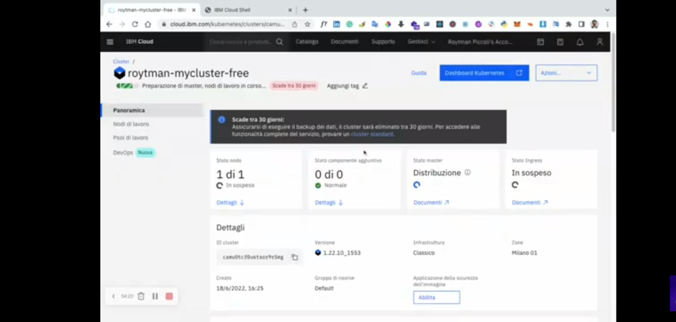

Slide 32
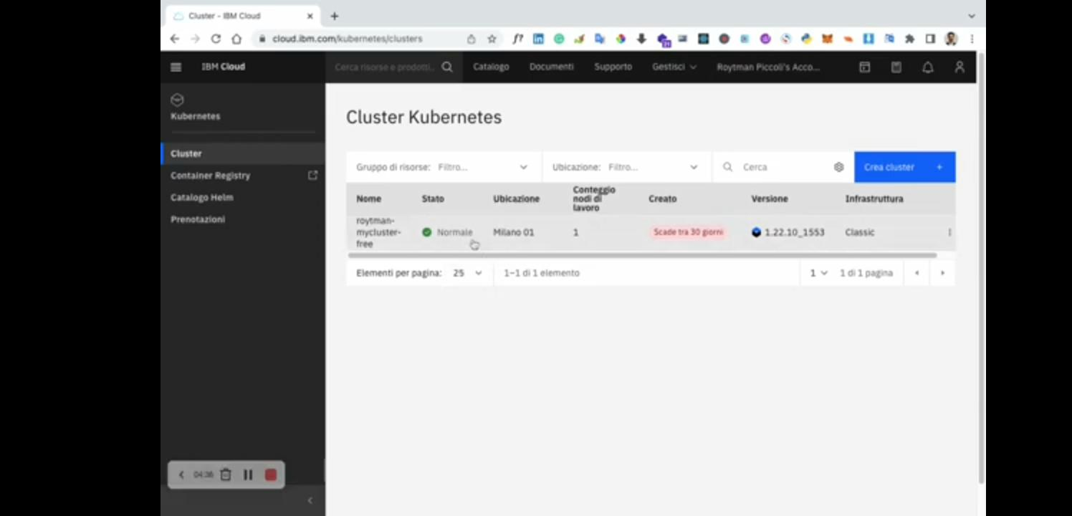

Slide 33
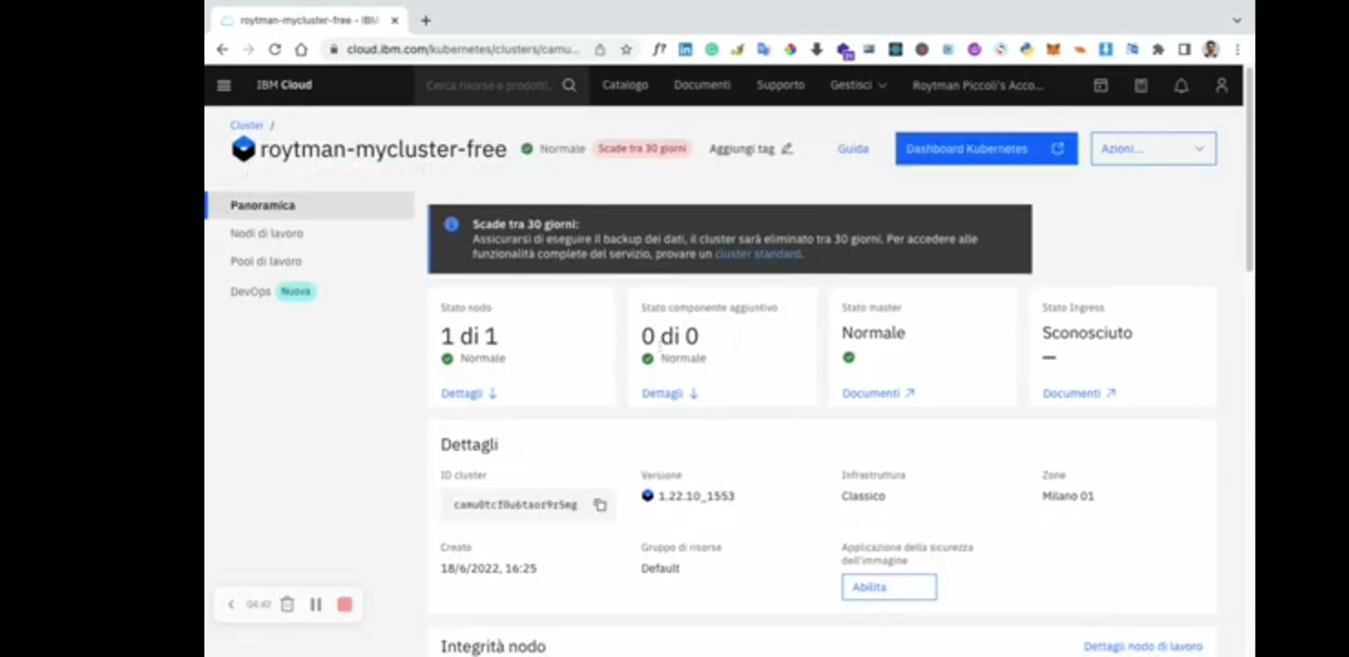

Slide 34
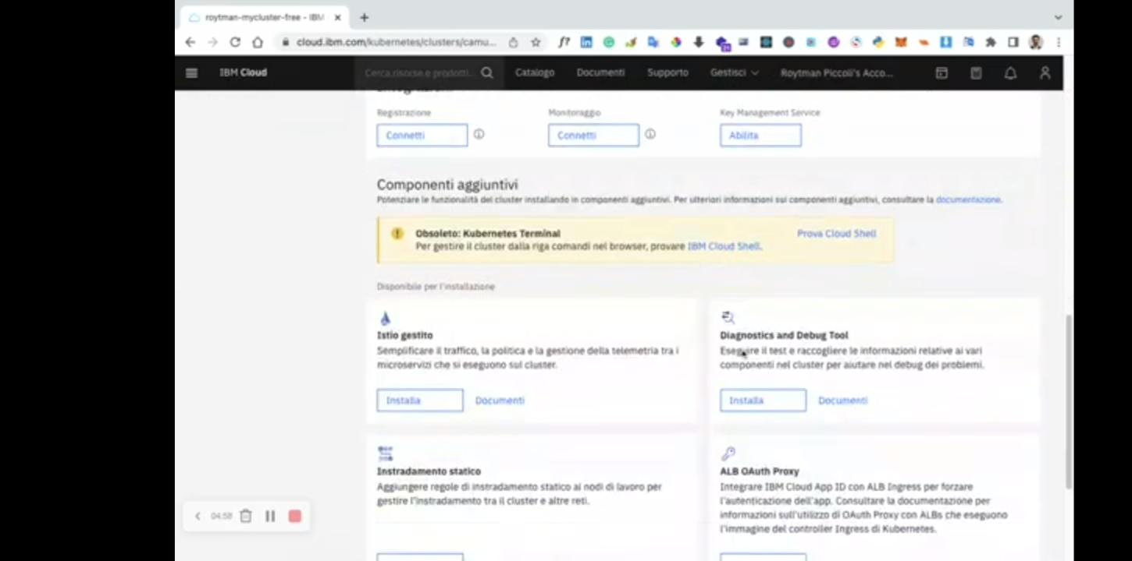

Slide 35
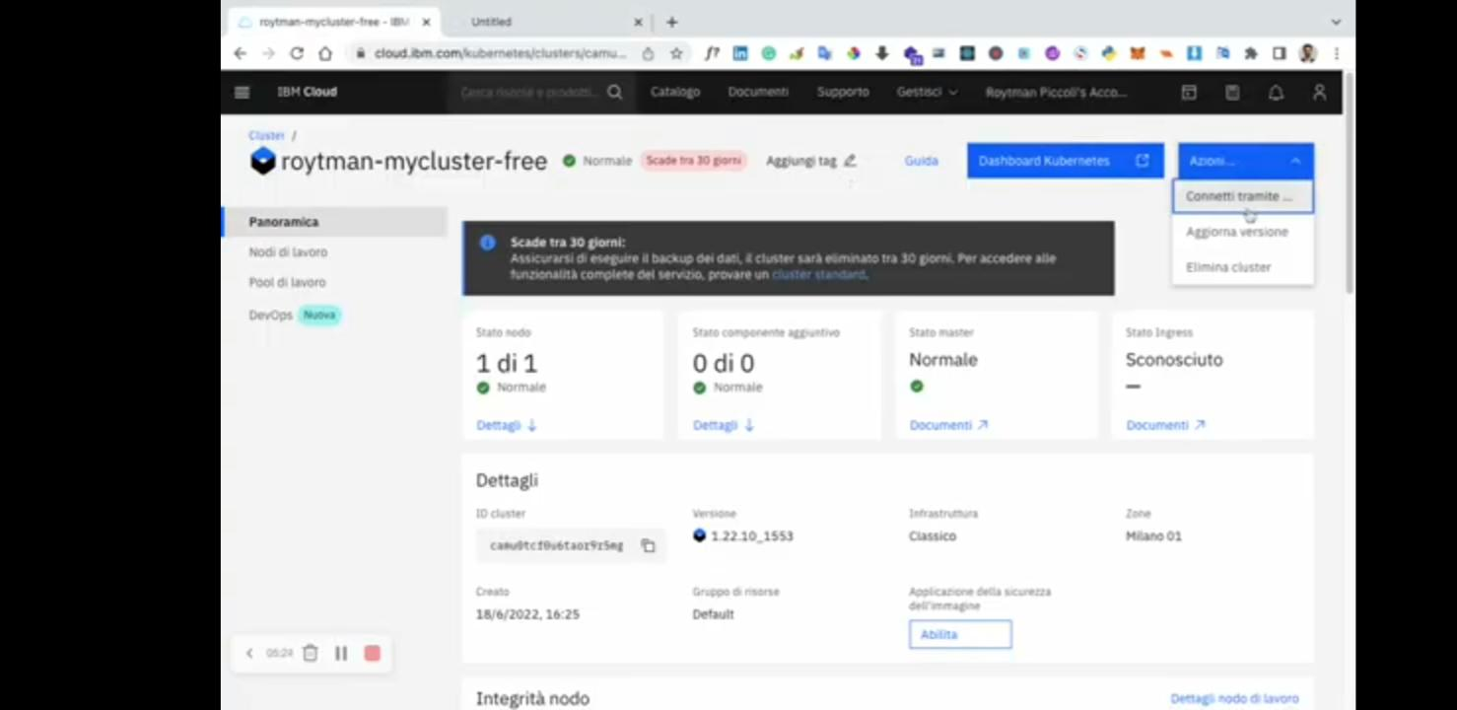

Slide 36
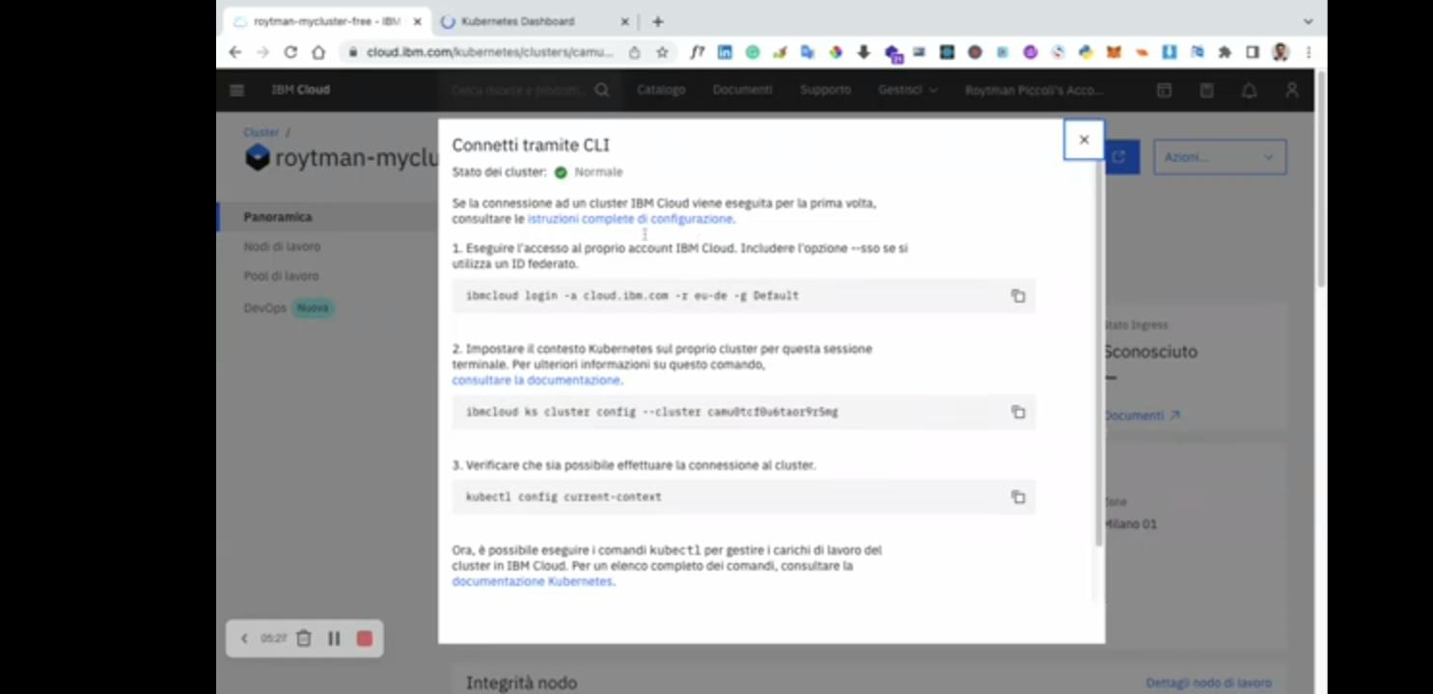

Slide 37
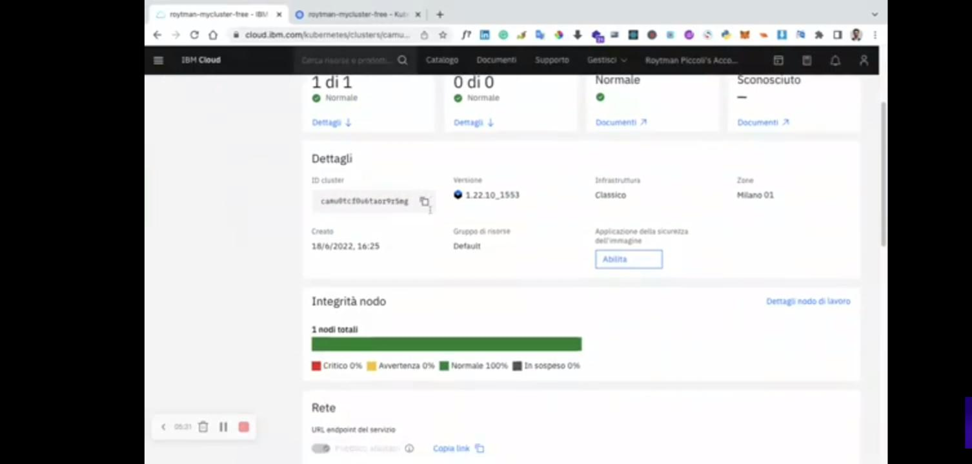

Slide 38


Slide 39
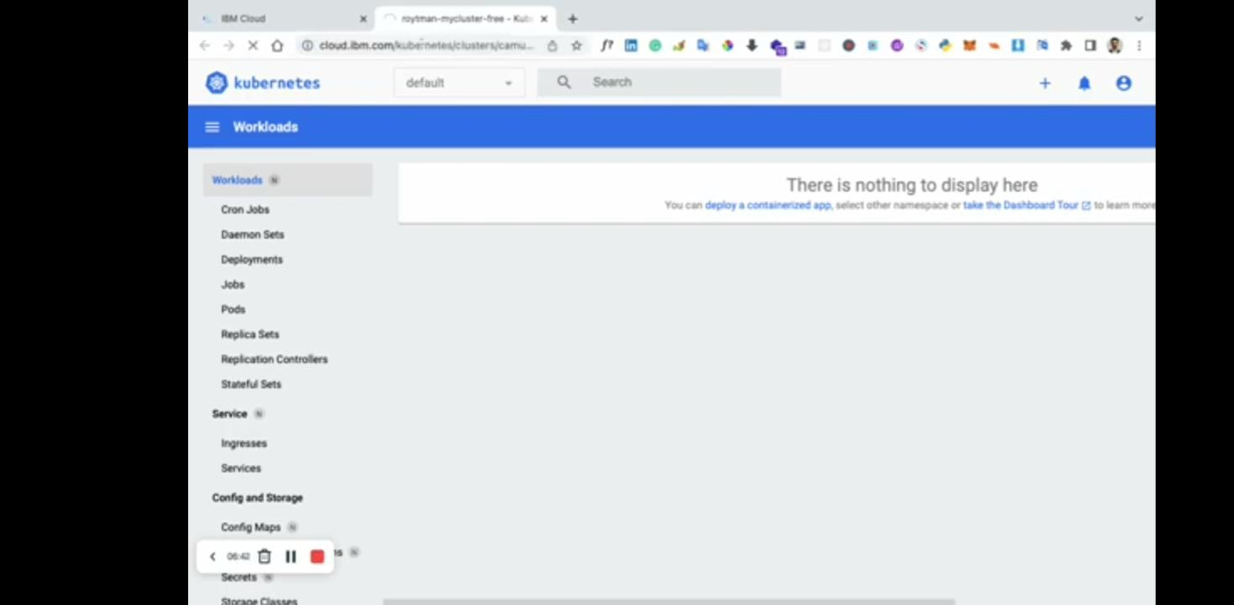

Slide 40
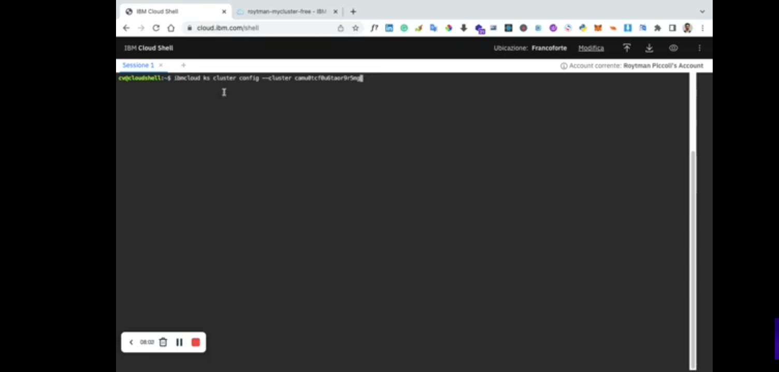

Slide 41
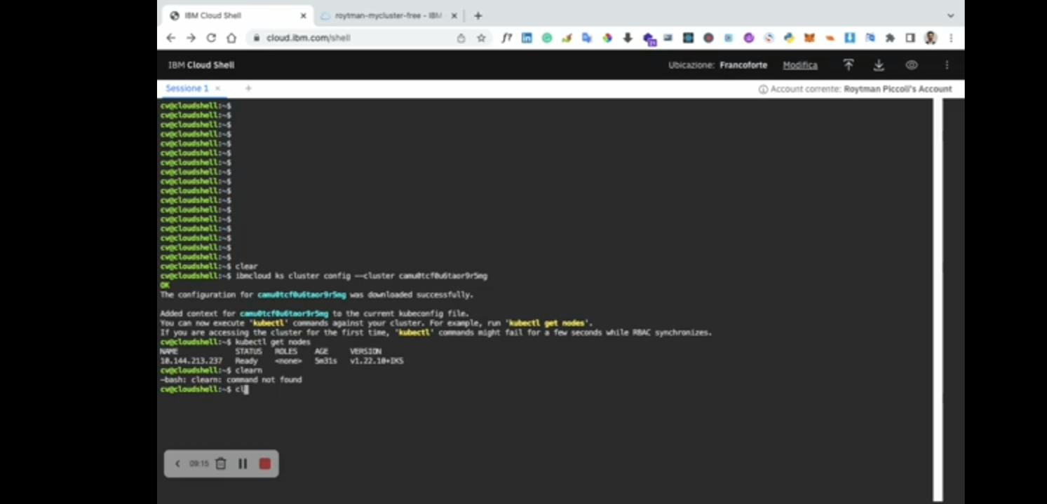

Slide 42
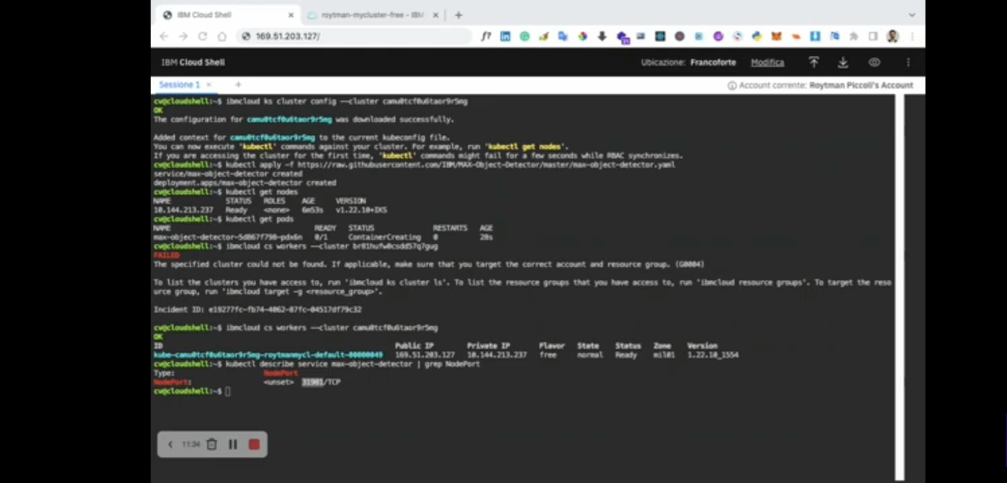

Slide 43
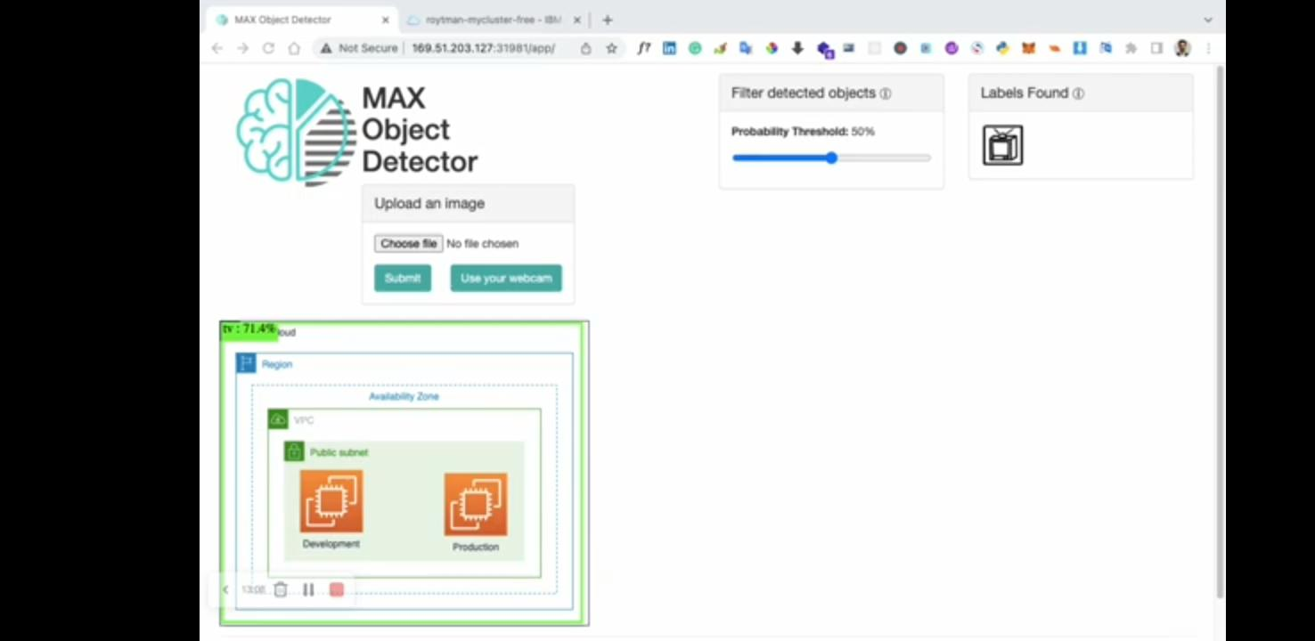

Slide 44
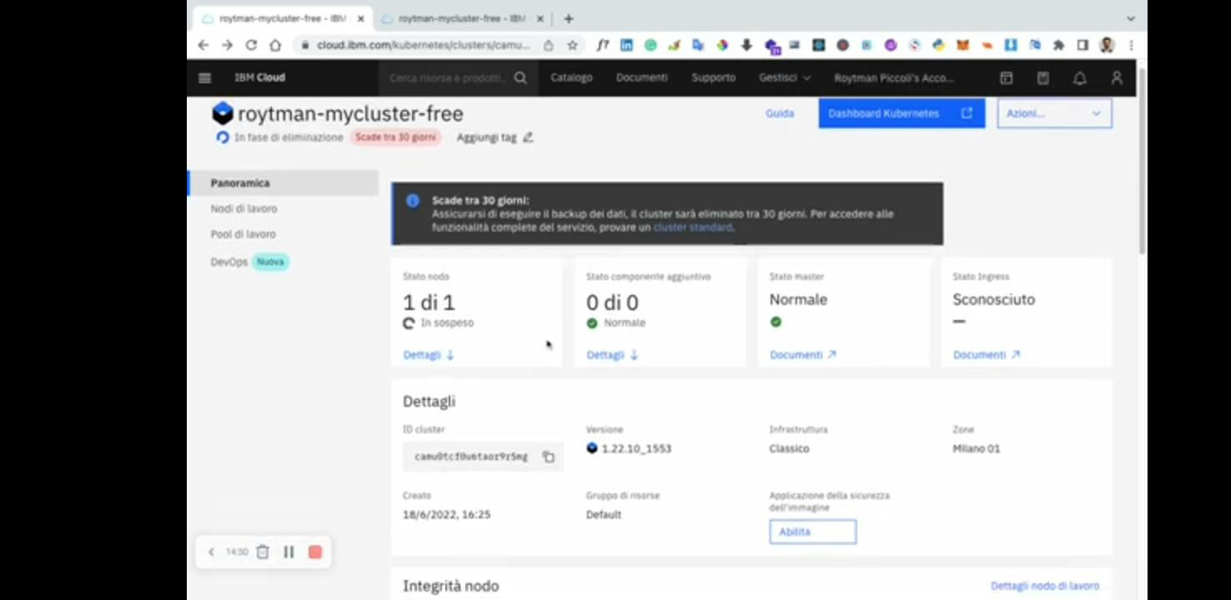

Slide 45
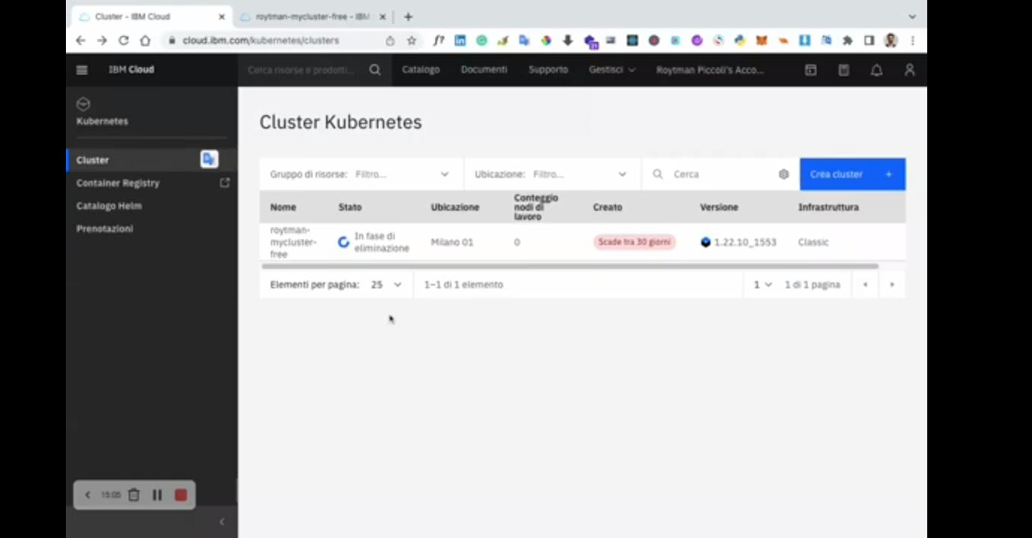

Slide 46
Name: D.Vimala
Dept: CSE
Year: III yr
Project Name: Chatbot Watson

